Slide 1
Project 3: Reddit
Natural Language Processing & Classification
Parenting vs CasualConversation
By Ethan
18 May 2020

Slide 2


Overview
Reddit is a social news collection and discussion site founded in 2005 by two college friends: Steve Huffman and Alexis Ohanian. It has evolved to a home site for many growing communities, also know as subreddits. Within each subreddits, the registered member can create a post and share content such as text stories, links, images, and videos. The rest of the community can comment on posts as a means of discussion. Comments & posts can be upvoted or downvoted like a ranking. The most interesting content rises to the top. There is a large number of subreddits community that surrounds almost any topic of interest you can think of and find like-minded folks. It has been a place for people to seek advice, comfort, share knowledge or humour, and many more.

Slide 3
Reddit Statistics
As of December 4, 2019
Average monthly active users: More than 430 Million
Active communities: More than 130 Thousand
Average screenviews per month: 21 Billion
5th Most visited site in US (on Alexa)

Slide 4
Problem Set
Given a post, able to classify correctly whether it belongs to Parenting or CasualConversation subreddit. This is a binary classification problem. We will later label Parenting as 1 and CasualConversation as 0.
Audience: Baby,toddlers or children retailers keen on knowing the concerns of parents

Slide 5

Contents
Import Libraries
Load Dataset from CSV
Data Cleaning
Choose stopwords library to use
Combine into X and y
Split data into training and testing sets
Words Preprocessing
Turn text into features
Baseline accuracy
Fit a Naive Bayes model
Fit a Logistic Regression model
Fit Random Forest Classifier
Combine a few models and get best score
Fine tuning Logistic Regression hyperparameters
Fit Final Logistic Model
Conclusion
Limitations and Recommendation
Sources

Slide 6
Reddit API to CSV
Successfully retrieved 752 posts each subreddit

Slide 7
Import libraries
Load csv

Slide 8
Macro Analysis
There are other variables that may be contribute better classification such as title,num_comments (number of comments).
But to make classification more challenging, I decide to simply look at 'selftext' which is the content of each subreddit post

Slide 9
Data Cleaning
Remove Null values: 2 null rows removed
Remove duplicates: one row of post is dropped for each subreddit. that is the pinned post by the moderator

Slide 10

Choose stopwords library to use
There are 3 libraries that I know to choose from:
wordcloud
NLTK
CountVectorizer
I decide to use unique words of wordcloud and nltk library stopwords because I find the words in Countvectorizer carry more meaning and includes numbers in words which may be useful for classifying parenting subreddit from casualconversation.
479,852 words in the combination of posts from CasualConversation Subreddit preprocessing.
784,425 words in the combination of posts from Parenting Subreddit preprocessing.
There are 63.5 % more words in Parenting compared to Casualconversation preprocessing

Slide 11
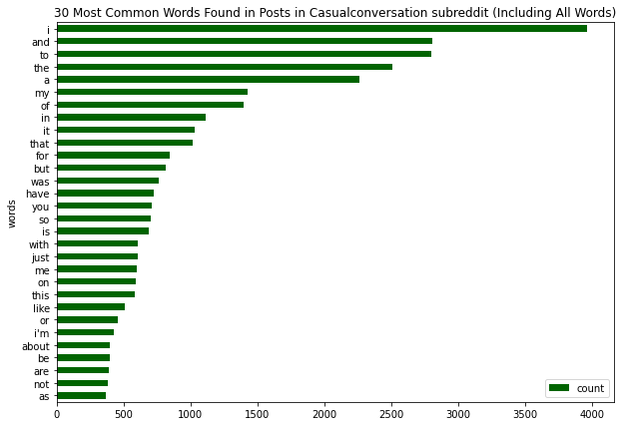

Slide 12
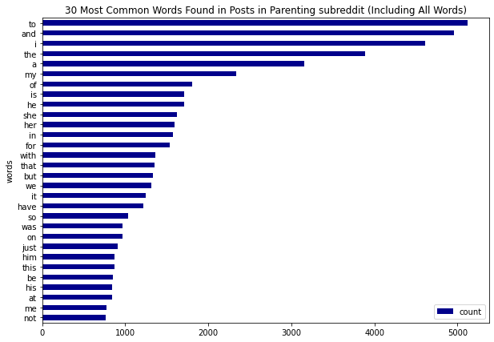

Slide 13
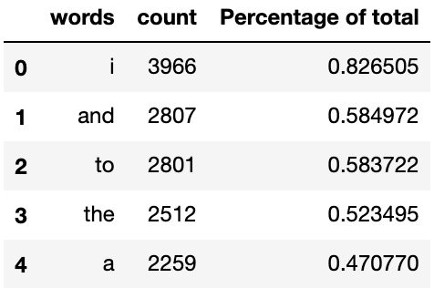
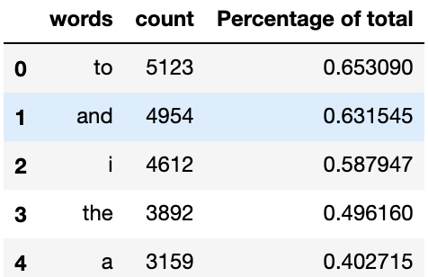
Selected stopwords
Selected stopwords for CasualConversation:
['i', 'and', 'to', 'the', 'a', 'my', 'of', 'in', 'it', 'that', 'for', 'but', 'was', 'have', 'you', 'so', 'is', 'with', 'just', 'me', 'on', 'this', 'like', 'or', "i'm", 'about', 'be', 'are', 'not', 'as', 'at', 'if', 'what', 'we', 'do', 'been', 'all', 'they', 'had', 'feel', 'when', 'get', 'really', 'out', 'from', 'how', 'some', 'up', 'i’m', 'know', 'he', 'because', 'would', 'her', 'your', 'people', 'one', 'time', 'can', 'she', "it's", 'an', 'more', 'who', "i've", 'am', "don't", 'them', 'has', 'even', 'think', 'now', 'it.', 'want', 'any', 'only', 'something', 'much', 'other', 'no', 'new', 'got', 'will', 'day', 'good', 'being’]
Selected stopwords for Parenting:
['to', 'and', 'i', 'the', 'a', 'my', 'of', 'is', 'he', 'she', 'her', 'in', 'for', 'with', 'that', 'but', 'we', 'it', 'have', 'so', 'was', 'on', 'just', 'him', 'this', 'be', 'his', 'at', 'me', 'not', 'or', 'has', 'like', 'as', 'when', 'do', 'are', 'our', 'all', 'if', 'up', 'what', 'about', 'they', 'been', 'time', 'get', 'how', 'you', 'will', 'out', 'from', 'know', "i'm", 'because', 'can', 'would', 'had', 'want', 'i’m', 'any', 'old', 'am', 'some', 'an', 'year', 'one', 'really', 'even', 'no', 'feel', 'kids', 'more', 'them', 'now', 'son', 'other', 'very', 'then', 'going', 'go', 'only', "don't", 'also', 'after', 'being']
Notes:
0.3%

Slide 14
Combine into X and y
Split data into training and testing sets

Slide 15
Word Preprocessing
Remove html
Remove non letters
Lower case
Remove Stopwords
Lemmatize

Slide 16
Turn text into features
Count vectorizer
TFID vectorizer

Slide 17

Baseline Accuracy
50%
We need to calculate baseline accuracy in order to tell if our model is better than null model

Slide 18

Fit Naive Bayes Model
Train score: 83.8 % of CV fold =5
Test score: 85.8 %

Slide 19

Confusion Matrix
True Negatives: 192
False Positives: 33
False Negatives: 31
True Positives: 195
In our classification problem, false positive and false negative is equally bad. Hence, looking at accuracy to select our model is better instead of sensitivity or specificity. But is good to see false positive and false negative are not too different from each other.

Slide 20
Fit Logistic Regression Model
Train score: 82.7 % of CV fold =5
Test score: 86.0 %

Slide 21
Fit Random Forest Classifier
rf_param = {
'n_estimators':[200,300,350],
'max_depth': [None,1,2] }
GridsearchCV Best parameters: {'max_depth': None, 'n_estimators': 200}
Train score: 83.6 % of CV fold =5
Test score: 85.1%

Slide 22
Compare models and get best score
models = [
MultinomialNB(),
LogisticRegression(),
RandomForestClassifier(max_depth=None, n_estimators= 300), #from gridsearchcv result earlier
ExtraTreesClassifier()
3 different test size for train_test_split
Test size = [0.3,0.25,0.20]
vectorizer = [
CountVectorizer(max_features=500),
TfidfVectorizer(max_features=500) ]

Slide 23
Best model from search
TfidfVectorizer
Test size ratio of 0.2
Logistic Regression
Score accuracy of 92%

Slide 24
Fine tuning Logistic Regression hyperparameters
Best parameters: C=1
Train score: 87% of CV fold =10
Test score: 91%
Overall, the best test score is: 91% which is better than baseline model of 50%.
Using Test size ratio of 0.2 do train-test-split again
Preprocessing
TFID Vectorizer
lg_param = { 'C':[0.1,0.2,0.5,0.8,1] }

Slide 25
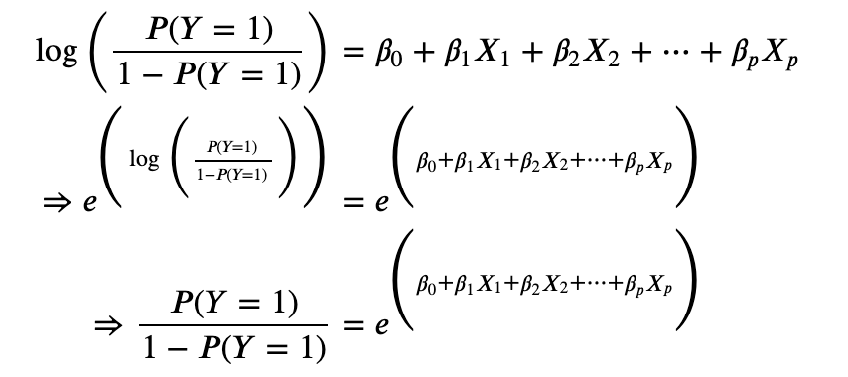
Conclusion
Logistic regression is the most common binary classification algorithm. We assume that each independent variable 𝑋𝑖 is linearly related to the log of the odds of success. To interpret the coefficients, we take the exponential of it. A one-unit change in 𝑋𝑖. Xi means that success(classify as parenting) is 𝑒xp(𝛽𝑖) times as likely.
As number of 'daughter' word increases by 1, the log-odds of the post coming from 'Parenting' subreddit increases by 3.47.
As number of 'daughter' word increases by 1, the post coming from 'Parenting' subreddit is about exp(3.47) times = 32.1 times as likely.

Slide 26
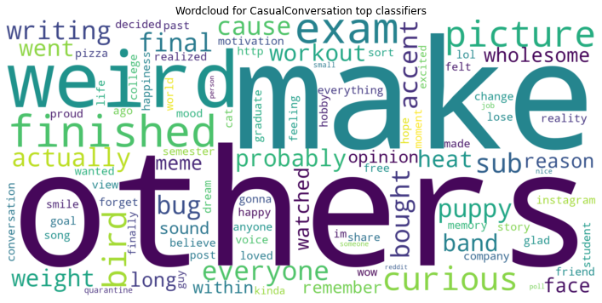

Slide 27
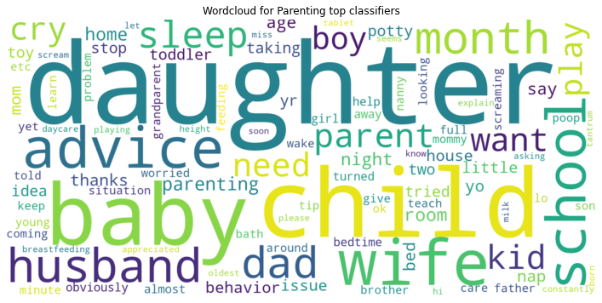
The wordclouds shows that the words that contributes to parenting subreddit tends to be much more specific to family and parenting related words like daughter,child,baby.
Whereas for casual conversation wordcloud suggest that the theme seems to range widely from exam,weight,weird etc.

Slide 28

Limitations and Recommendation
The data is collected at fix point in time. Hence, there may be limitations to the model ability to predict future posts and classify them correctly. However, since parenting subreddit inherently surrounds a theme quite well, the predicting ability may not be affected much.
Recommendations:
the data to be collected over a period of time and combined
more data
try other models such as KNN
Try Ngram

Slide 29

Thank you!

